Slide 1
Lead scoring Case Study
Group Members
Anany Sharma
Aswin Karthik P

Slide 2
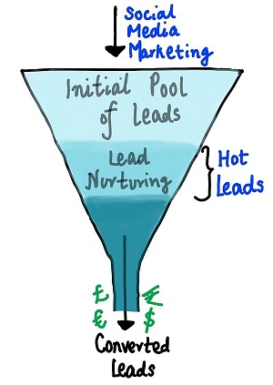
Problem Statement
X Education sells online courses to industry professionals
X Education gets a lot of leads (people who have shown interest to join the courses through online marketing), but the conversion is 30%
To make this process more efficient, the company wishes to identify the most potential leads, also known as ‘Hot Leads’.
Hot Leads can lead to increased conversion rates, since the sales team will focus on potential leads who have higher chances of joining the course

Slide 3

Business Objective
A ballpark of the target lead conversion rate of 80% has been set by the CEO. 50% more then current conversion rate.
Build a logistic regression model to assign a lead score between 0 and 100 to each of the leads
Understand various underlying factors affecting the conversion and how to control them to drive positive results
Provision to handle future constraints and suggestion for the same

Slide 4
Approach
Data import and Basic data understanding
Checking missing value and imputation
Cleaning Data
Numerical Variable Analysis – Univariate and Multivariate
Exploratory Data Analysis
Dummy Variable Creation
Test and Control Split and Numerical variable scaling
Functions to Modularize codes
Automated Feature elimination using RFE
Manual Feature Elimination using p-val and VIF factors
Model Evaluation on Training set
ROC AUC Analysis
Stability of the model using 5-fold cross validation
Optimal Cutoff for improving model accuracy
Precision recall Curve Analysis
Testing model with optimal cutoff on test data
Logistic Regression Modelling
Conclusion and Summary
Subjective Questions Answering

Slide 5
Data Import and Basis Data Understanding
The data has 9240 rows and 37 columns
Out of 37 columns
3 columns are of Integer type
4 columns are of Float type
30 columns are of Object type (String, which may contain categorical and ordinal variables)
Prospect ID and Lead Number is an ID column, we need to verify if they are unique.
Converted is Target column and has the value of 0 and 1.

Slide 6
Exploratory Data Analytics – Missing values and Cleaning Data (1/2)
Column | Missing Value %
How did you hear about X Education | 78.46
Lead Profile | 74.19
Lead Quality | 51.59
Asymmetrique Profile Score | 45.65
Asymmetrique Activity Score | 45.65
Asymmetrique Activity Index | 45.65
Asymmetrique Profile Index | 45.65
City | 39.71
Specialization | 36.58
Tags | 36.29
What matters most to you in choosing a course | 29.32
What is your current occupation | 29.11
Country | 26.63
Page Views Per Visit | 1.48
TotalVisits | 1.48
Last Activity | 1.11
Lead Source | 0.39
Column | Missing Value %
Receive More Updates About Our Courses | 0
I agree to pay the amount through cheque | 0
Get updates on DM Content | 0
Update me on Supply Chain Content | 0
A free copy of Mastering The Interview | 0
Prospect ID | 0
Newspaper Article | 0
Through Recommendations | 0
Digital Advertisement | 0
Newspaper | 0
X Education Forums | 0
Lead Number | 0
Magazine | 0
Search | 0
Total Time Spent on Website | 0
Converted | 0
Do Not Call | 0
Do Not Email | 0
Lead Origin | 0
Last Notable Activity | 0

Slide 7
Exploratory Data Analytics – Missing values and Cleaning Data (2/2)
We have 18 columns with missing value.
Based on the missing value proportion and Data Dictionary we are planning to drop columns with more than 45% of missing values
Imputation strategy is to fill NA values with mode (most common value) or creates a new category like “Not Given”
Post Imputation, if the variable doesn’t offer any imputation then we drop it
Note: All observations and strategies are explained for each variable in the notebook

Slide 8
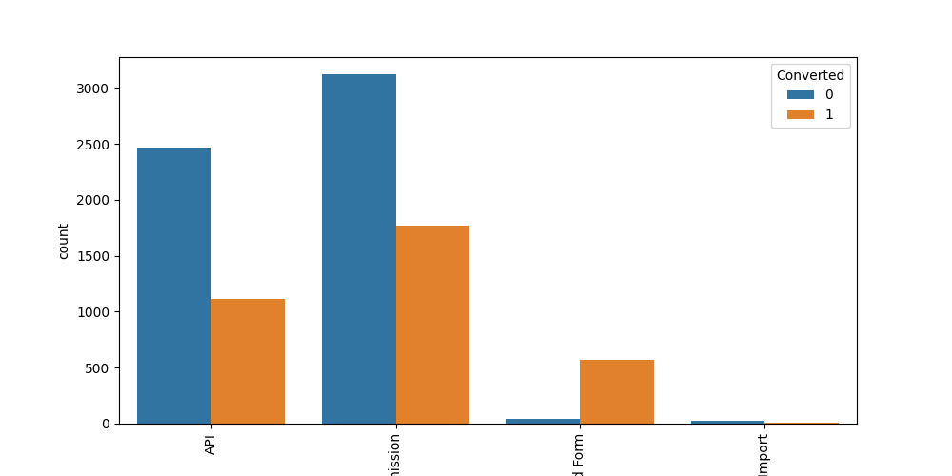
Exploratory Data Analytics – Cleaning Data (Categorical Bivariate Analysis) (1/12)
LEAD ORIGIN
No change is required except for dummy creations.
API and Landing Page submission generate the larger proportion of leads, but the conversion rate is low.

Slide 9
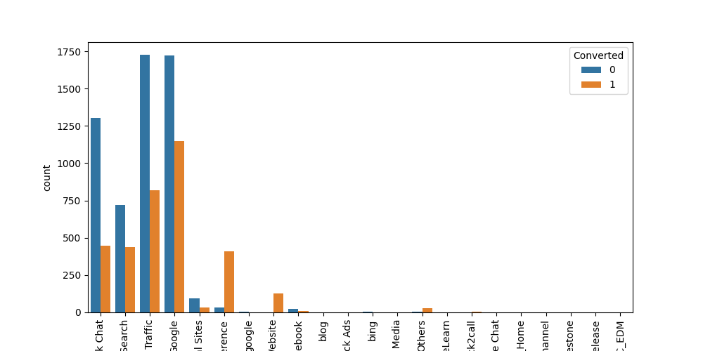
Exploratory Data Analytics – Cleaning Data (Categorical Bivariate Analysis) (2/12)
LEAD SOURCE
There are some duplications like Google and google, Facebook and social media. Which can be clubbed together
Also a lot of sources have very low frequency which can be clubbed under “Others”. ( < 0.1)

Slide 10
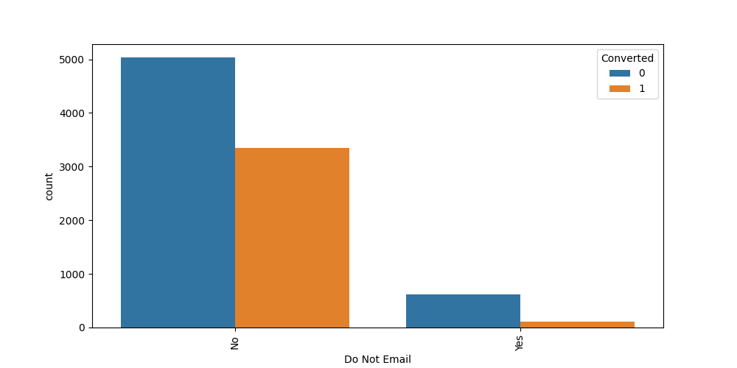
Exploratory Data Analytics – Cleaning Data (Categorical Bivariate Analysis) (3/12)
DO NOT EMAIL
Doesn’t need any cleaning

Slide 11
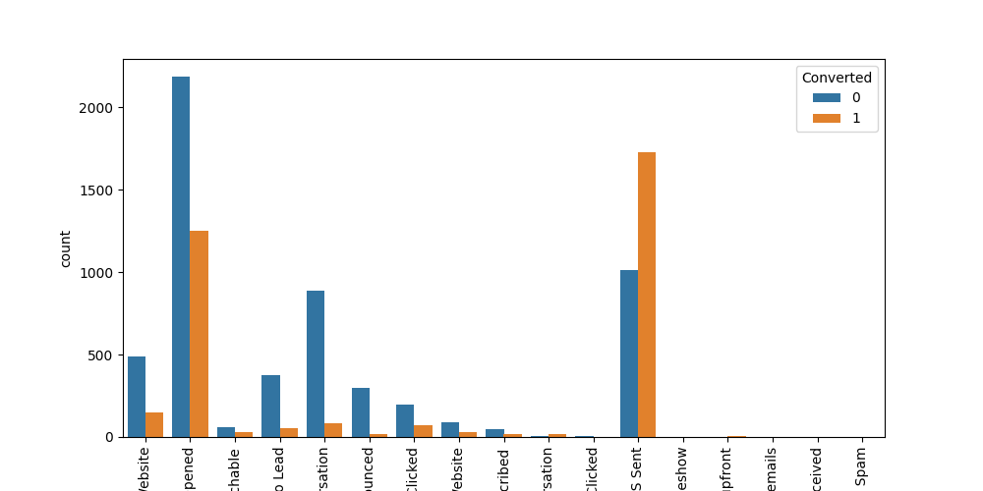
Exploratory Data Analytics – Cleaning Data (Categorical Bivariate Analysis) (4/12)
LAST ACTIVITY
We can combine low occurring values into “Others”

Slide 12
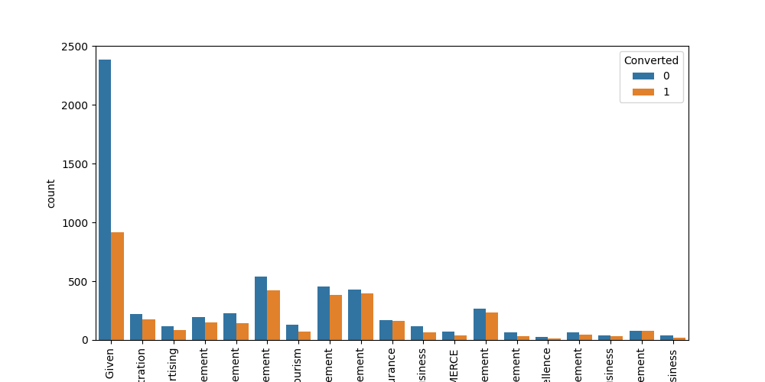
Exploratory Data Analytics – Cleaning Data (Categorical Bivariate Analysis) (5/12)
SPECIALIZATION
No Change required

Slide 13
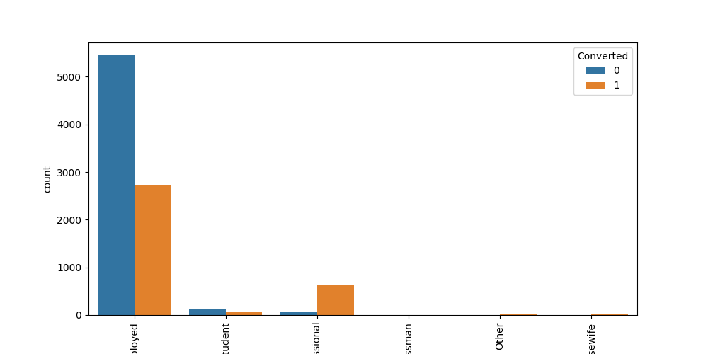
Exploratory Data Analytics – Cleaning Data (Categorical Bivariate Analysis) (6/12)
WHAT IS YOUR CURRENT OCCUPATON
No Change required

Slide 14
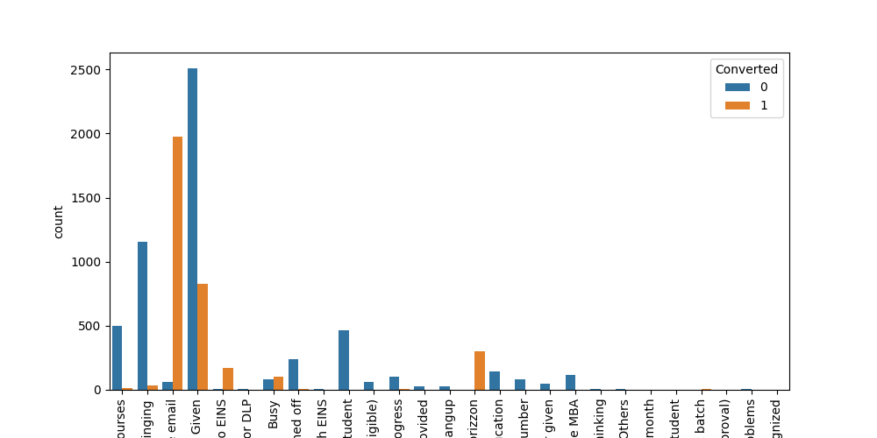
Exploratory Data Analytics – Cleaning Data (Categorical Bivariate Analysis) (7/12)
TAGS
Replace low frequency values with “Others”

Slide 15
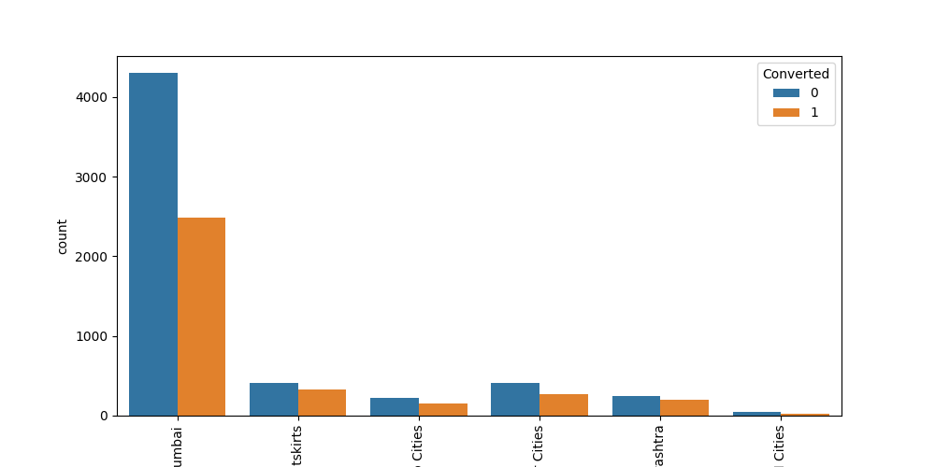
Exploratory Data Analytics – Cleaning Data (Categorical Bivariate Analysis) (8/12)
CITY
No changes required

Slide 16
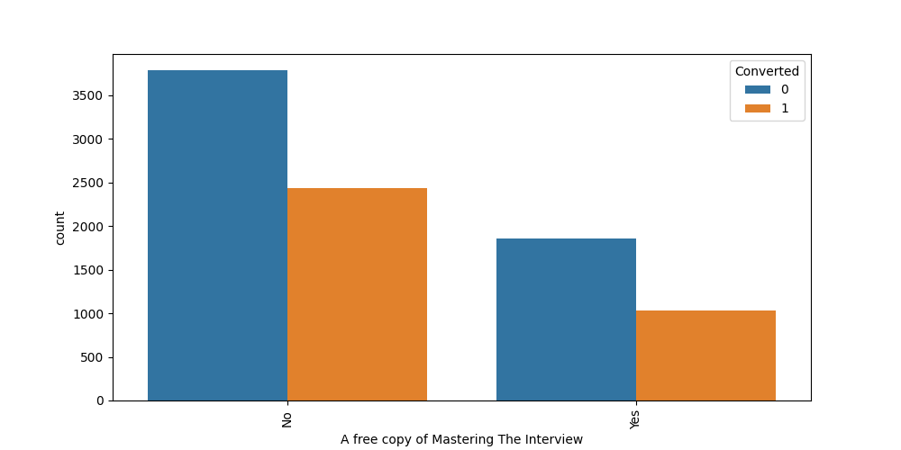
Exploratory Data Analytics – Cleaning Data (Categorical Bivariate Analysis) (9/12)
A FREE COPY OF MASTERING THE INTERVIEW
No changes required

Slide 17
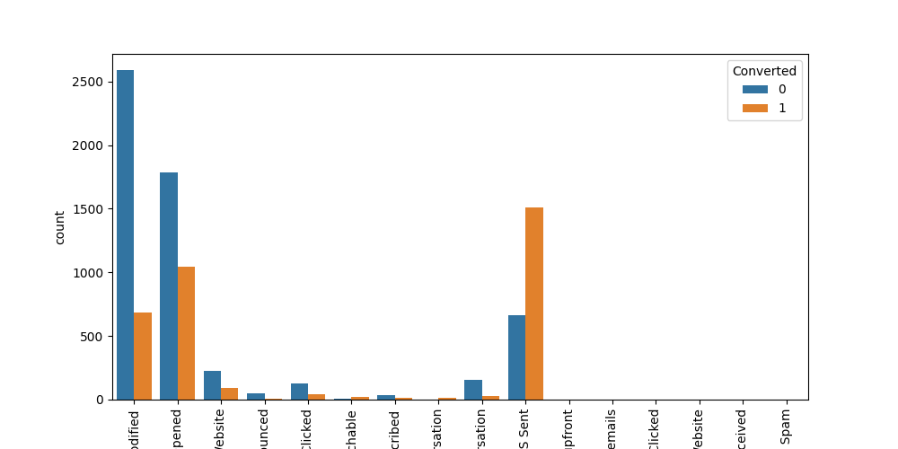
Exploratory Data Analytics – Cleaning Data (Categorical Bivariate Analysis) (10/12)
LAST NOTABLE ACTIVITY
Replace less frequent values with Others

Slide 18
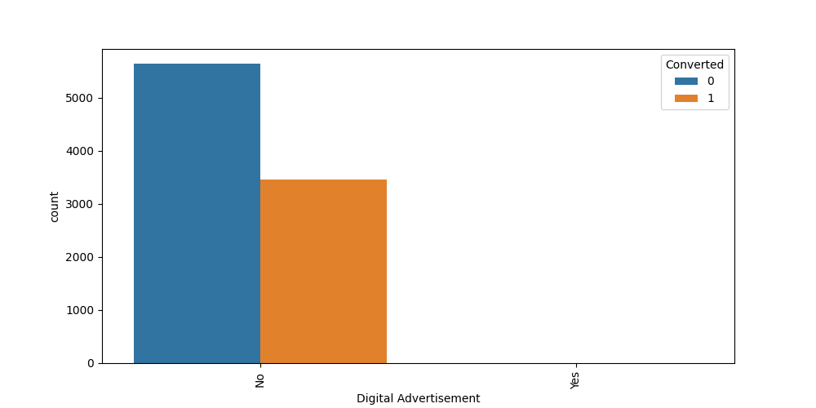
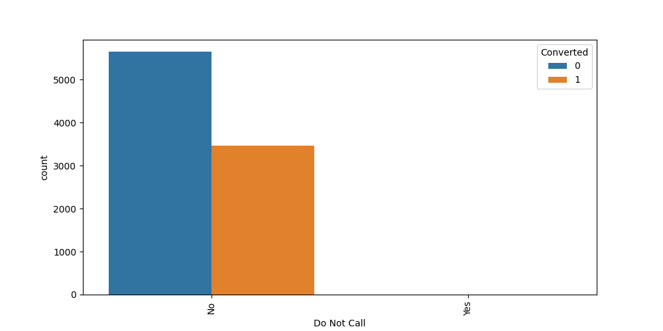
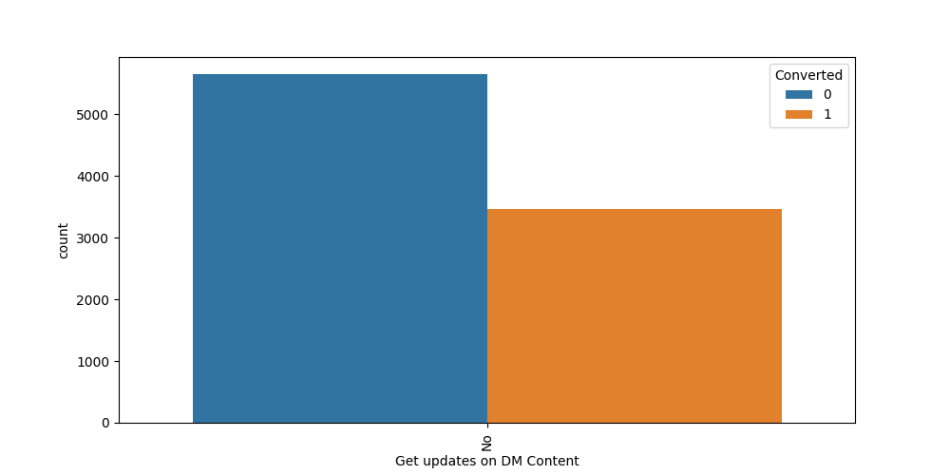


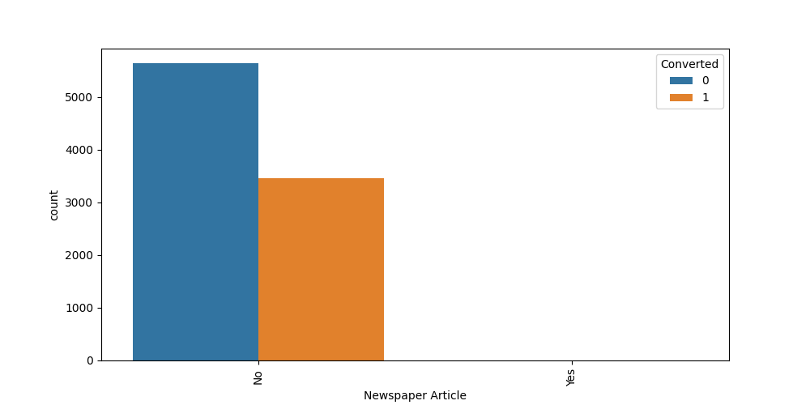
Exploratory Data Analytics – Cleaning Data (Categorical Bivariate Analysis) (11/12)
DIGITAL ADVERTISEMENT
DO NOT CALL
GET UPDATES ON DM CONTENT
I AGREE TO PAY THE AMOUNT THROUGH CHEQUE
MAGZINE
NEWSPAPAER ARTICLE
More than 99% of the values are No, hence there is not variance from which the model can learn.
We can drop the variable

Slide 19


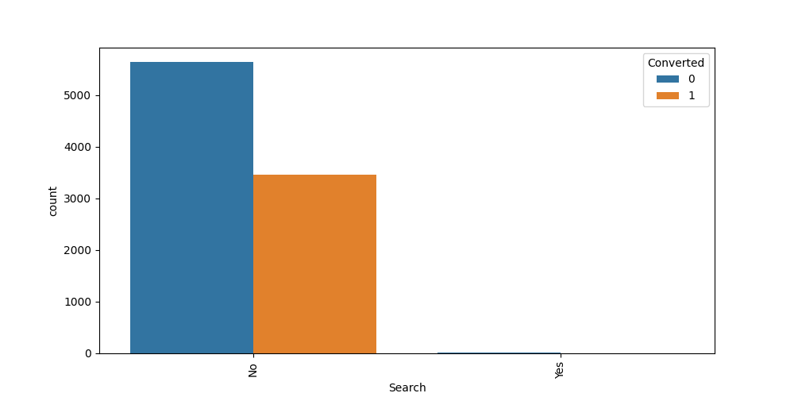



Exploratory Data Analytics – Cleaning Data (Categorical Bivariate Analysis) (12/12)
NEWSPAPER
RECEIVE MORE UPDATES ABOUT OUR COURSES
SEARCH
THROUGH RECOMMENDATIONS
UPDATE ME ON SUPPLY CHAIN CONTENT
X EDUCATION FORUMS
More than 99% of the values are No, hence there is not variance from which the model can learn.
We can drop the variable

Slide 20
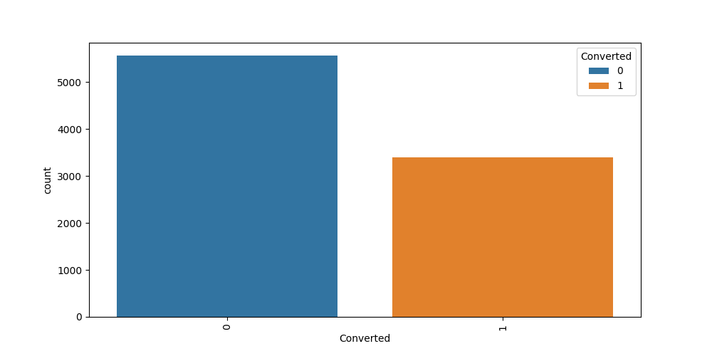
Exploratory Data Analytics – NUMERICAL ANALYSIS (UNIVARIATE) (1/2)
CONVERTED (TARGET VARIABLE)
Converted is a binary variable with 0 or 1 flag
We don’t see a huge class imbalance (62% vs 38%)

Slide 21
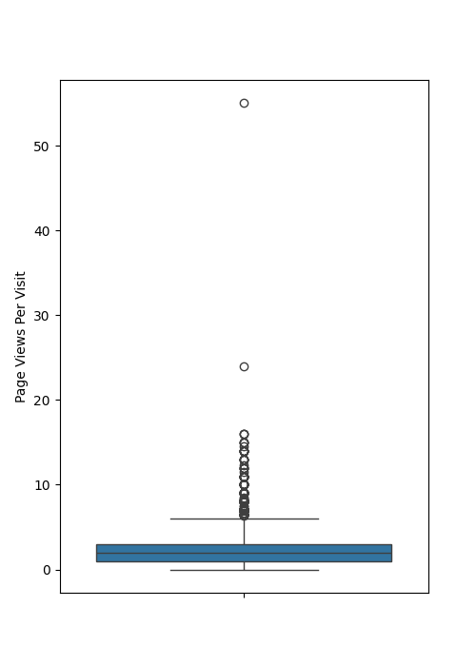
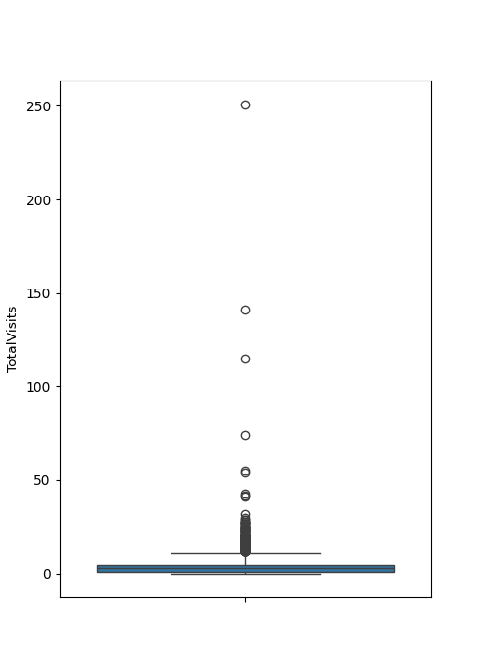
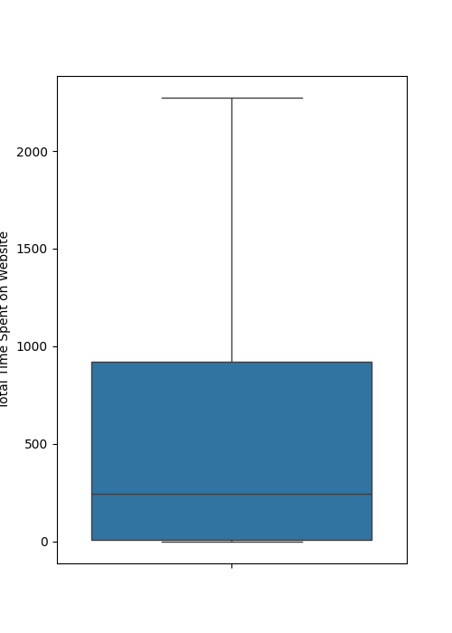
Exploratory Data Analytics – NUMERICAL ANALYSIS (UNIVARIATE) (2/2)
PAGE VIEWS PER VISIT
TOTALVISITS
TOTAL TIME SPENT ON WEBSITE
Total Time Spent on Website doesn't have any outliers.
TotalVisits and Page Views Per Visit is left skewed and the values above 99th percentile causes the issues. Hence lets cap the higher value at 99th percentile

Slide 22
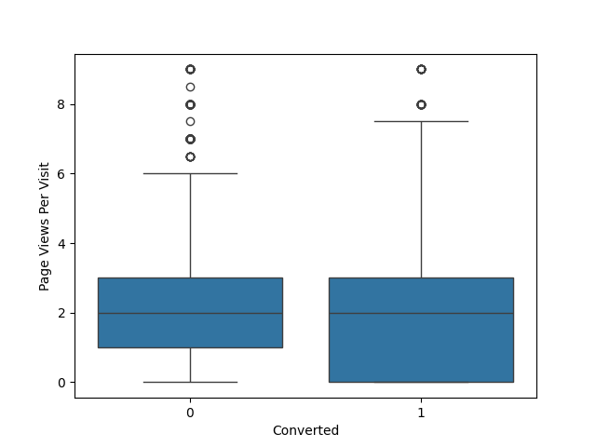
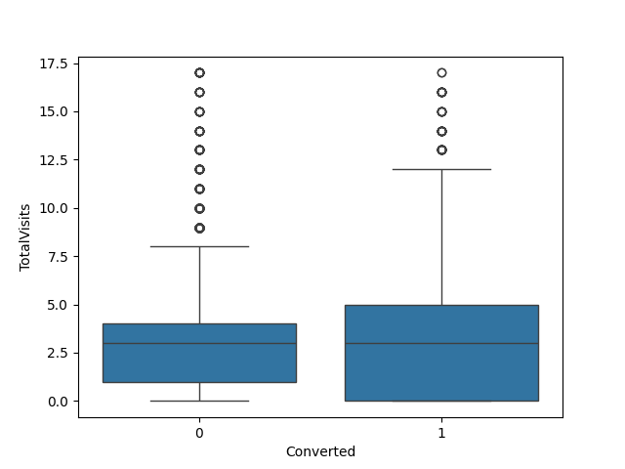
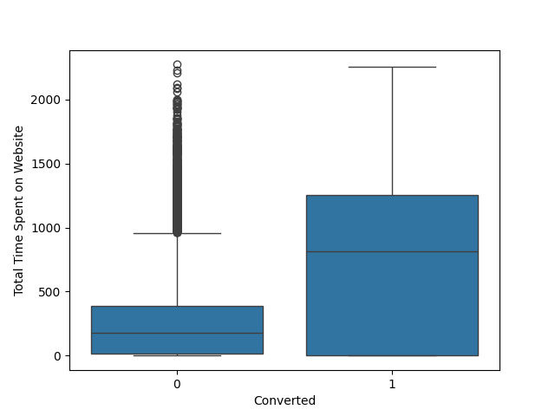
Exploratory Data Analytics – NUMERICAL ANALYSIS (MULTIVARIATE) (1/2)
CONVERTED
VS
CONVERTED
VS
CONVERTED
VS
PAGE VIEWS PER VISIT
TOTALVISITS
TOTAL TIME SPENT ON WEBSITE
Nothing conclusive can be said based on Total Visits, since the median of 1 and 0 are very close
Nothing conclusive can be said based on Page Views Per Visit, since the median of 1 and 0 are very close
More time spent on website, leads to more conversion of leads, since the median of 1 is much larger than 0 for Total Time Spent on Website

Slide 23
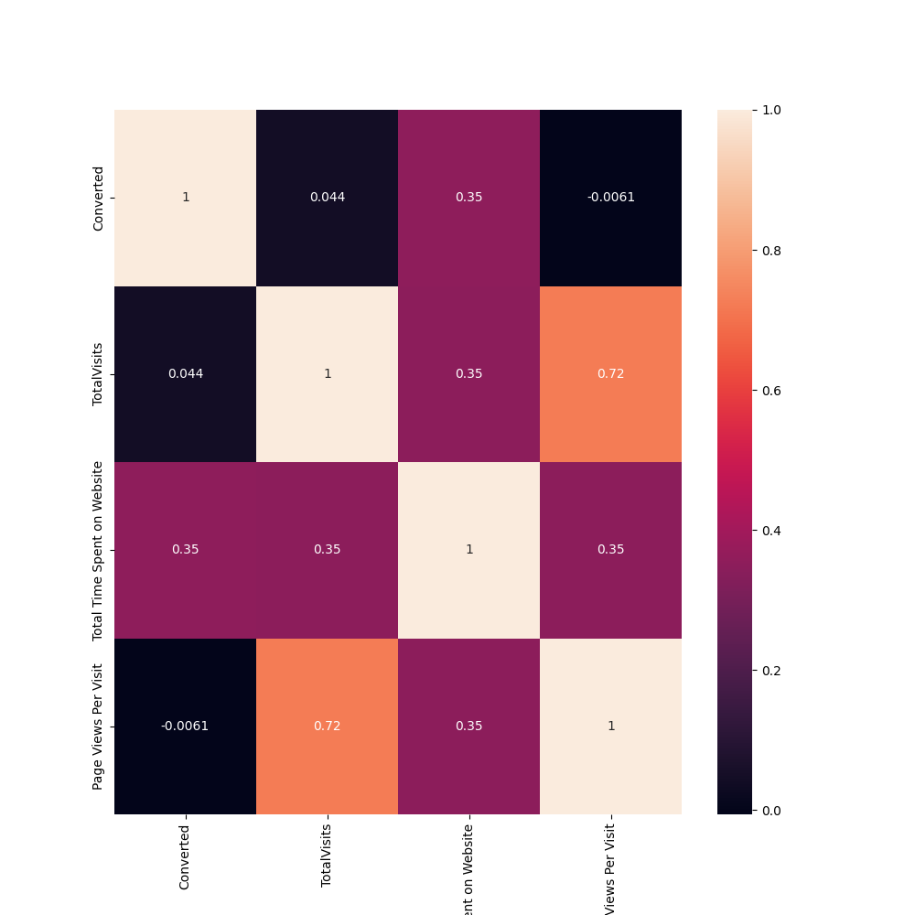
Exploratory Data Analytics – NUMERICAL ANALYSIS (MULTIVARIATE) (2/2)
HEATMAP
Reaffirms the above observation, since the correlation between Total Time Spent on Website is the highest wrt Converted
TotalVisits and Page Views Per Visit are highly correlated. We can use anyone of this variable, but lets wait for RFE results to be sure

Slide 24
DUMMY VARIABLE CREATION
For all the categorical variables, dummy variables are created before starting the modelling activity
For columns without “Others”, “Not given” etc. cuts, we create dummy and drop first
Lead Origin, City, A free copy of Mastering The Interview, Do Not Email
For columns with “Others”, “Not given” etc. cuts, we consciously drop the “Others” or “Not given” dummy variables in maintain the meaning of the variables
Lead Source, Last Activity, Specialization, Tags, Last Notable Activity, What is your current occupation
Post dummification we have 73 variables in total

Slide 25
Train Test Split and Numerical variables scaling for Modelling
We create a 80%-20% random train and test split of the data
All the numerical values in the train are standardized using Standard Scaler – Making the variables mean close to 0 and standard deviation close to 1
Test data set will be standardized on the go, while scoring

Slide 26
Linear regression modelling
15 important features are selected using RFE on logistic regression models. All the numerical features are eliminated as a part of RFE
Post this manual feature elimination was done based on p-val of the variables and VIF factor
We have a final set of 13 features
Features | P-val | VIF | Variable importance | Effect
Tags_Closed by Horizzon | 0 | 1.17 | 7.7505 | Positive
Tags_Lost to EINS | 0 | 1.04 | 6.6826 | Positive
Tags_Will revert after reading the email | 0 | 0.04 | 4.889 | Positive
Last Notable Activity_Modified | 0 | 0.01 | 4.889 | Positive
Tags_Already a student | 0 | 0.31 | -4.0012 | Negative
Tags_switched off | 0 | 1.02 | -3.9578 | Negative
Tags_invalid number | 0 | 1.01 | -3.8987 | Negative
Lead Source_Welingak Website | 0.023 | 1.31 | 3.5596 | Positive
Tags_Ringing | 0 | 0.18 | -3.1902 | Negative
Tags_Not doing further education | 0.007 | 1.03 | -2.7734 | Negative
Last Activity_SMS Sent | 0 | 0.06 | 2.1749 | Positive
Tags_Interested in other courses | 0 | 0.42 | -1.7412 | Negative
Tags_Interested in full time MBA | 0.017 | 1.02 | -1.4207 | Negative
Lead Origin_Lead Add Form | 0 | 0.75 | 0.8907 | Positive

Slide 27
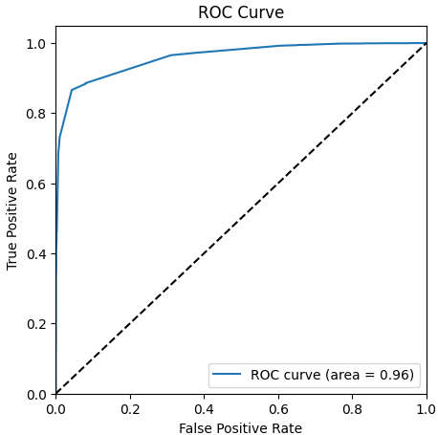
Model Performance on Training data (0.5 cutoff)
CONFUSION MATRIX
Actual/Predicted | 0 | 1
0 | 4250 | 192
1 | 364 | 2356
PERFORMANCE METRICS
Metrics | Performance
Accuracy | 92.2%
Precision | 92.4%
Recall/Sensitivity | 86.6%
Specificity | 95%
The performance metrics are stable across all runs.
Recall can be improved. And as expected, it shows the conversion rate is above 80% as per CEO’s vision
The ROC AUC is 0.96 which suggests that the model is a good one

Slide 28
Model Stability – 5-Fold Cross Validation on Training Data
CV Run | Accuracy | Precision | Recall
1 | 93.2% | 93.4% | 88.4%
2 | 93% | 92.2% | 89.1%
3 | 91% | 91.1% | 84.7%
4 | 91.8% | 92.8% | 85.3%
5 | 91.9% | 92.8% | 85.5%
mean | 92.2% | 92.5% | 86.6%
std | 0.9% | 0.8% | 2%
In the 5-fold cross validation on the training set, the stability of the model is pretty good
We can see that the standard deviation for accuracy and precision is close to 1% and but recall is bit higher at 2% which is acceptable
The mean of the performance metrics are in the acceptable range and shows the model performance is good throughout

Slide 29
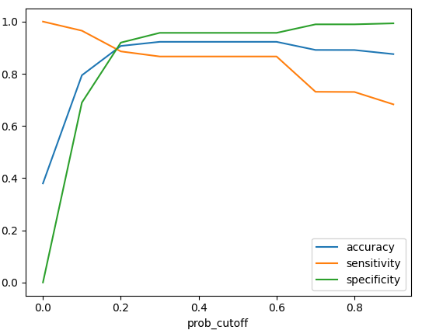
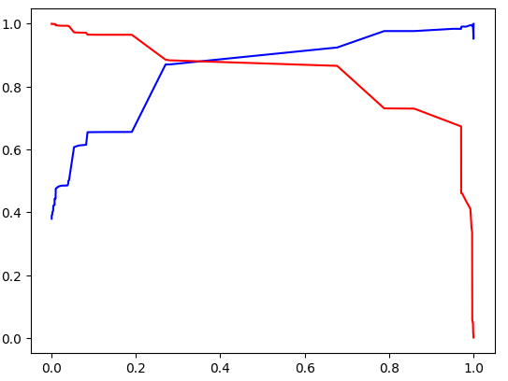
Cut-off Analysis
CONFUSION MATRIX
PRECISION VS RECALL
CUTOFF: 0.2
CUTOFF: 0.35
Metrics | Performance
Accuracy | 90%
Precision | 87%
Recall/Sensitivity | 88.5%
Specificity | 91%
Metrics | Performance
Accuracy | 92.2%
Precision | 92.5%
Recall/Sensitivity | 86.6%
Specificity | 95.6%
The performance of 0.35 cut-off is marginally good since it had better accuracy, precision, specificity than 0.2 cut-off model.
It is slightly off in recall, but that’s fine. Since, counting a lead as potential conversion case even if may not is better than leaving a potential conversion case out.

Slide 30
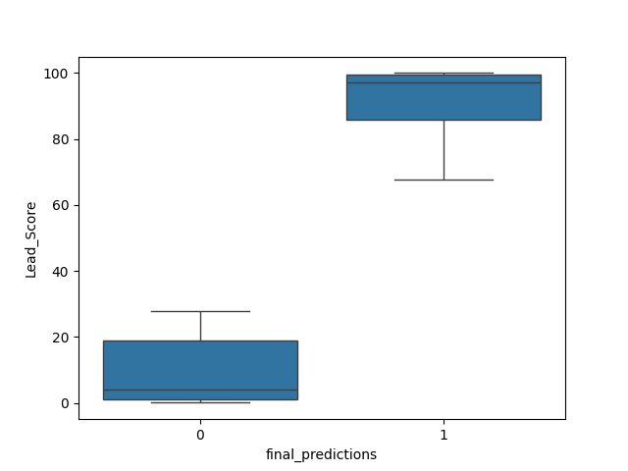
Test Data Performance (CUTOFF – 0.35) and Lead Score
CONFUSION MATRIX
Actual/Predicted | 0 | 1
0 | 1060 | 56
1 | 88 | 587
LEAD SCORE DISTRIBUTION OF TEST DATA
PERFORMANCE METRICS
Metrics | Performance
Accuracy | 92%
Precision | 91.2%
Recall/Sensitivity | 87%
Specificity | 95%
The performance on the test data is very good and is consistent with training data
Lead score the 100*Prediction Probability
As expected in the problem statement, we get higher scores for hot leads which have a greater potential to get converted.

Slide 31
Conclusion
The current status of the leads, denoted by the Tags places a very crucial part in scoring the leads
10 out of 13 important variables are based on Tags
Tags like closed by Horizzon, Lost to EINS and Will revert after reading email has higher positive impact towards conversion
Tags like Already a student, switched off and invalid number has a high negative impact towards conversion. These tags makes sense logically.
Last Notable Activity with Modified values has a good positive impact towards conversions
Last Activity of SMS sent has a good positive impact on lead conversions too.
Welingak Website as a Lead Source has a reasonable positive impact towards conversions
Leads originating from Lead Add forms have a low but positive impact towards conversions
Tags such as Ringing, Not doing further education, Interested in other courses and Interested in full time MBA has a reasonable negative impact on towards the conversion
Tags
Last Notable Activity
Last Activity
Lead Source
Lead Origin
Closed by Horrizon
Lost to EINS
Will revert after reading the email
Modified
SMS Sent
Welingak Website
Lead Add forms
Already a student
Switched off
Invalid Number
Ringing
Not doing further education
Interested in other courses
Interested in full time MBA

Slide 32
Thank You !

